Slide 1


QUICKSTART SERIES

Slide 2
SKELETAL
TRACKING
FUNDAMENTALS

Slide 3
QUICKSTART SERIES
Installing and Using the Kinect Sensor
Setting up your Development Environment
Camera Fundamentals
Working with Depth Data
Skeletal Tracking Fundamentals
Audio Fundamentals

Slide 4
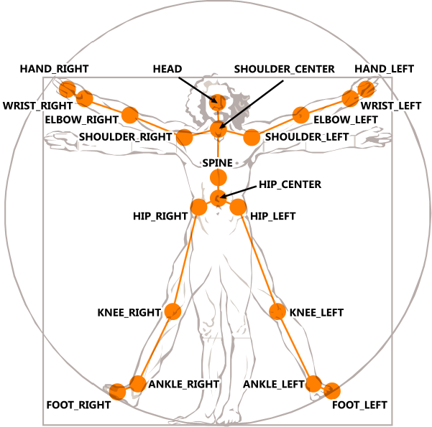
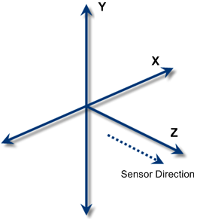
SKELETON DATA

Slide 5
SKELETAL JOINTS
Each player with set of <x, y, z> joints in meters
Each joint has associated state
Tracked, Not tracked, or Inferred
Inferred - Occluded, clipped, or low confidence joints
Use TransformSmoothParameters to smooth joint data to reduce jitter

Slide 6
SKELETAL TRACKING
Maximum two players tracked at once
Six player proposals per Kinect
Each skeleton has a unique identifier - TrackingID
SkeletonStream
Set AppChoosesSkeletons to false
Use ChooseSkeletons method to choose which skeletons to track

Slide 7
SKELETAL TRACKING
DEMO

